Slide 1

Cadmus Technologies
BY: EZEQUIEL TORRES

Slide 2
Cadmus Technologies
Our Mission and Vision
First
Only
Notes:
To provide network solutions to clients that who need services who offer best of both world both security and conveniences.
We explain our slogan and our title of why we chose that name.

Slide 3
Network Proposal for The Tops Casino
Business Locations: 4
Headquarters: 1
Notes:
The Four business locations are as followed : Hawaii, Kyoto, Greece, Las Vegas
Headquarters location .
Going to revamp

Slide 4
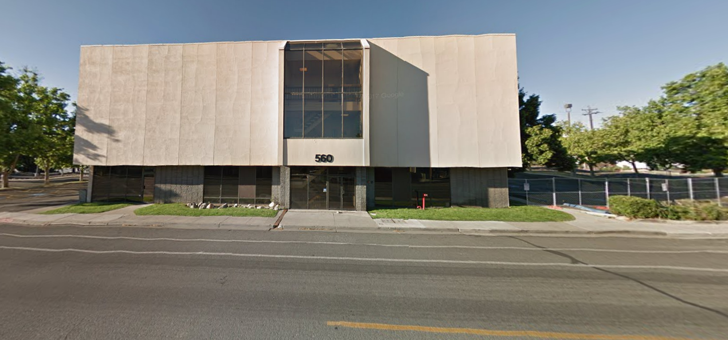
Tops HQ
Notes:
Three floors located in Penn.

Slide 5
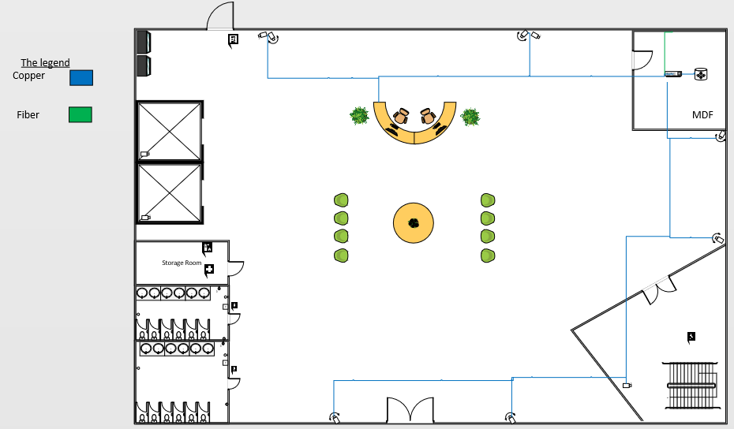
Tops HQ Wired Floor plans

Slide 6
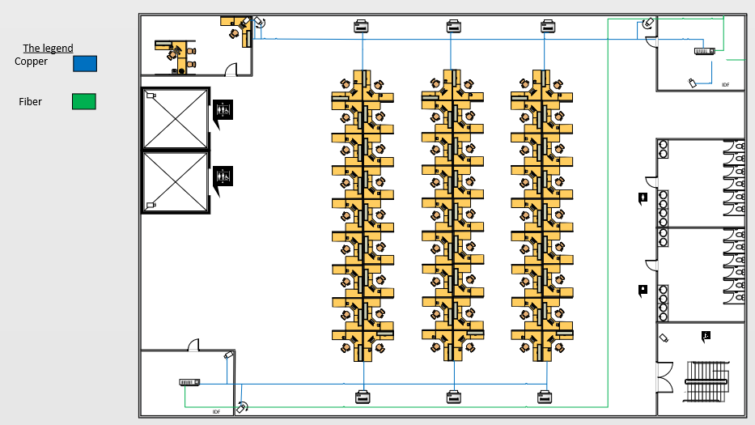
Tops HQ Wired Floor plan 2

Slide 7
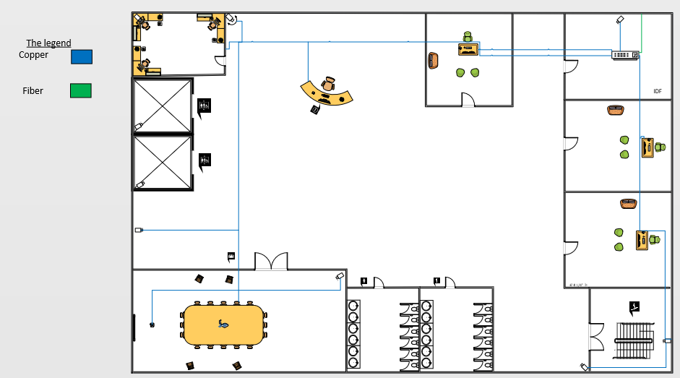
Tops HQ Wired Floor plan 3

Slide 8
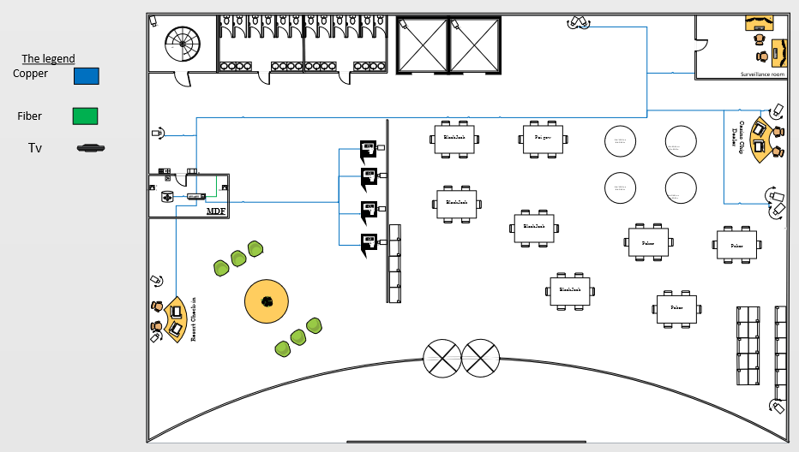
Tops Casino Resort Wired Floor plans

Slide 9
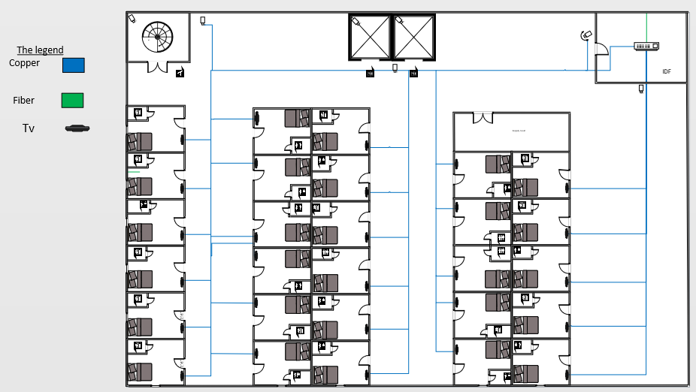
Tops Casino Resort Wired Floor plans

Slide 10
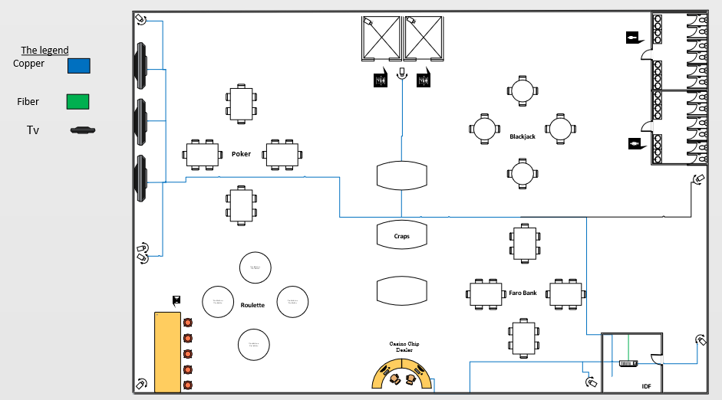
Tops Casino Resort Wired Floor plans

Slide 11
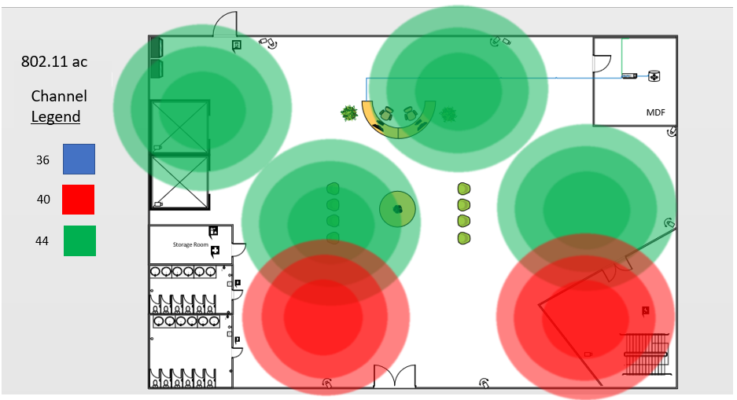
Tops HQ Wireless Floor plan 1

Slide 12
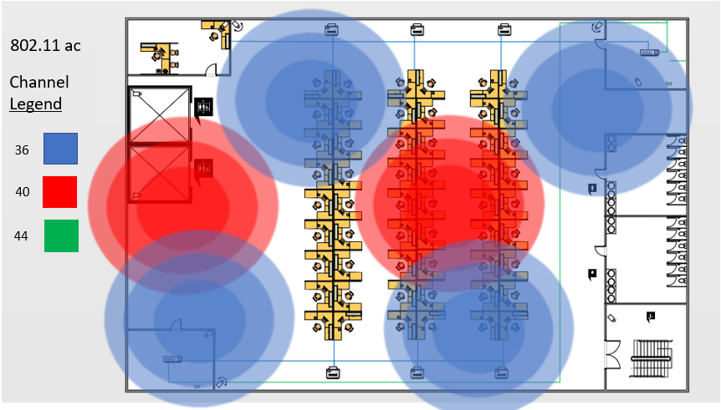
Tops HQ Wireless Floor plan 2

Slide 13
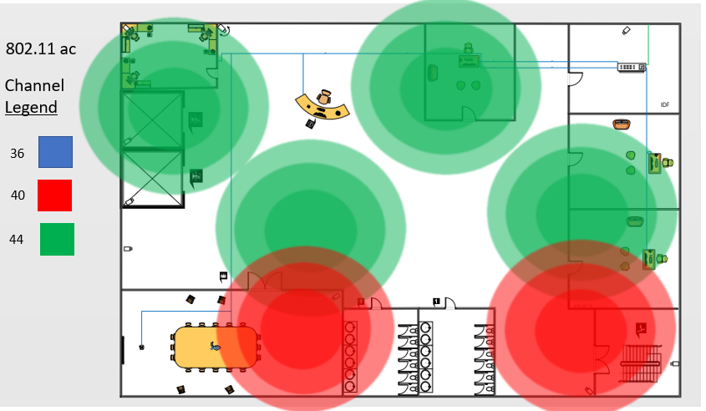
Tops HQ Wireless Floor plan 3

Slide 14


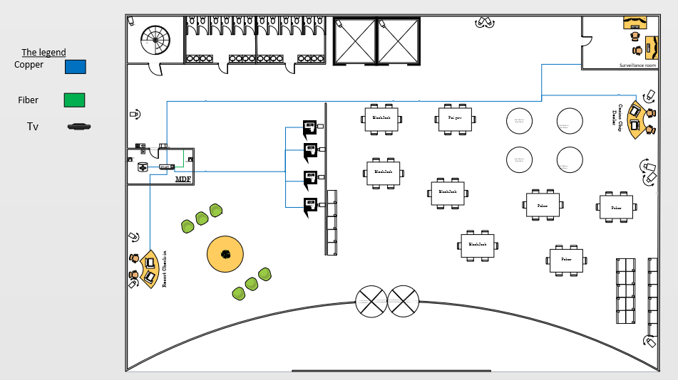

Tops Casino Wireless Floor plan 1
802.11 ac
Channel
Legend
36
40
44

Slide 15
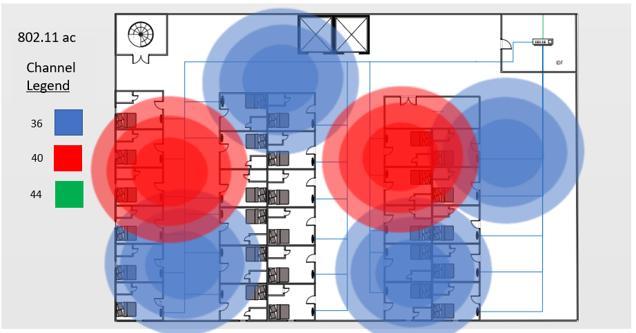
Tops Casino Wireless Floor plan 2

Slide 16
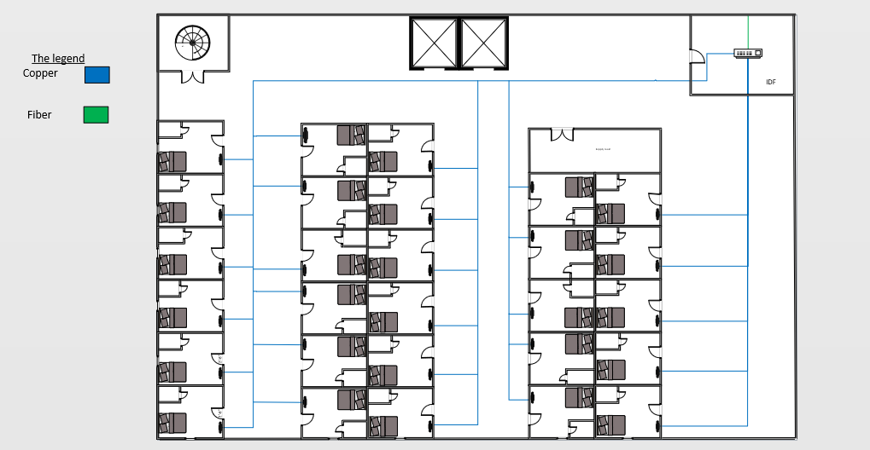
Tops Casino Wireless Floor plan 3
802.11 ac
Channel
Legend
36
40
44

Slide 17

Tops Casino Wireless Floor plan 4
802.11 ac
Channel
Legend
36
40
44

Slide 18
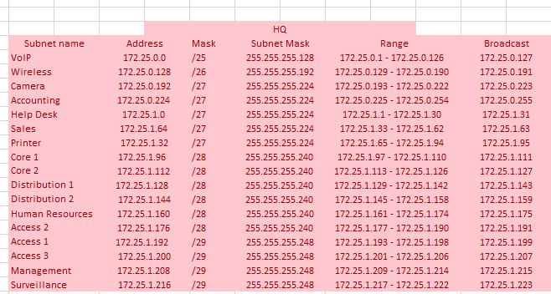
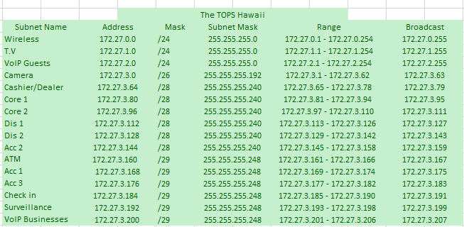
LAN IPv4 Addressing Scheme

Slide 19
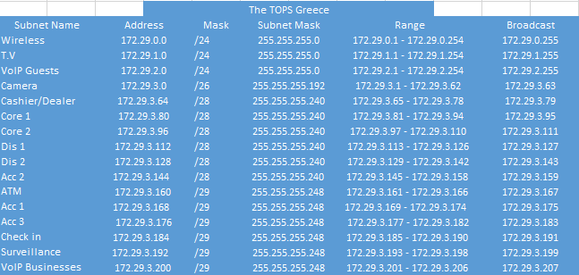
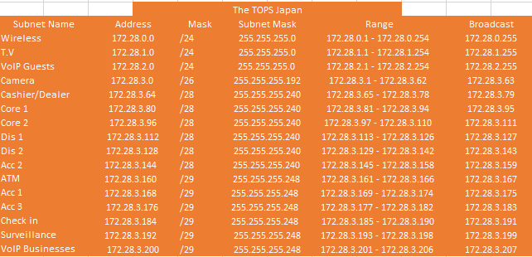
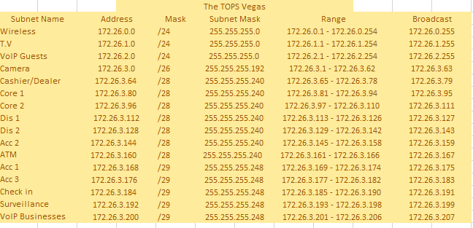
LAN IPv4 addressing Scheme

Slide 20
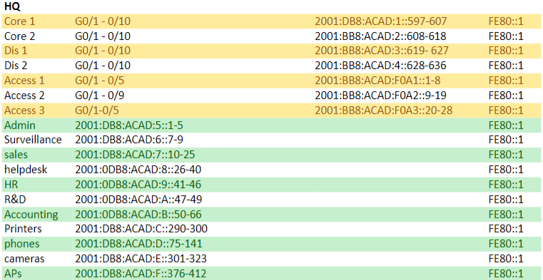
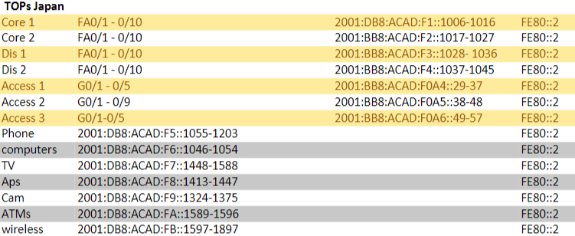
LAN IPv6 Addressing Scheme

Slide 21
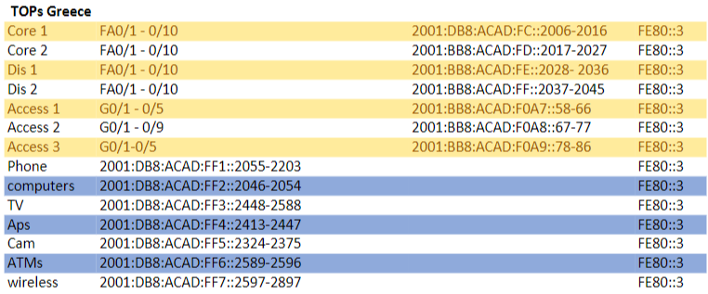
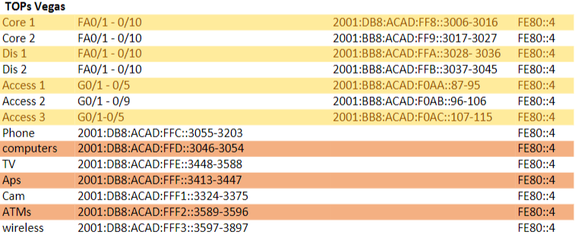
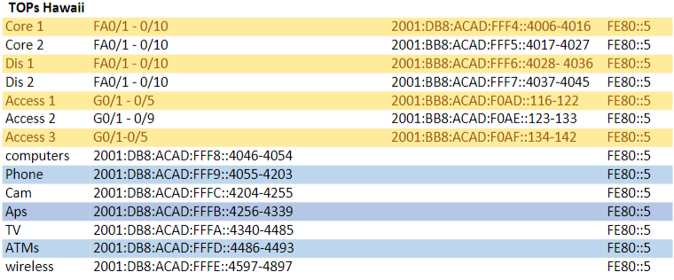
LAN IPv6 Addressing Scheme

Slide 22
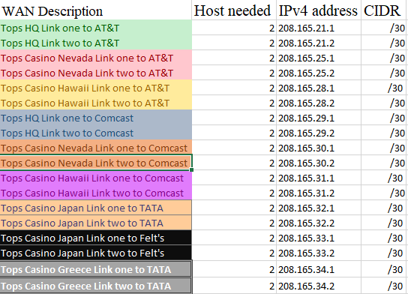
WAN IPv4 Addressing Scheme

Slide 23
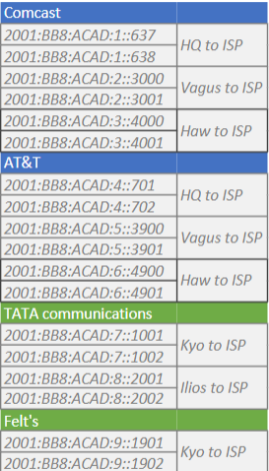
WAN IPv6 Addressing Scheme

Slide 24
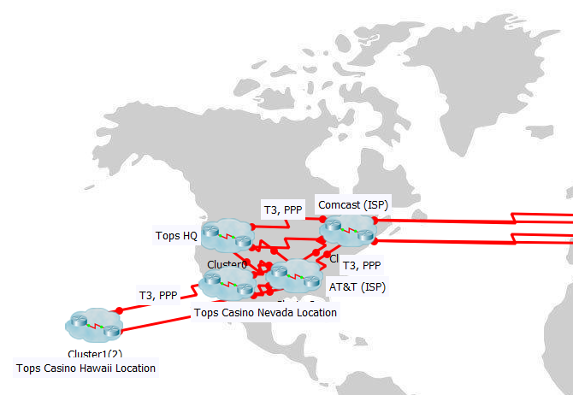
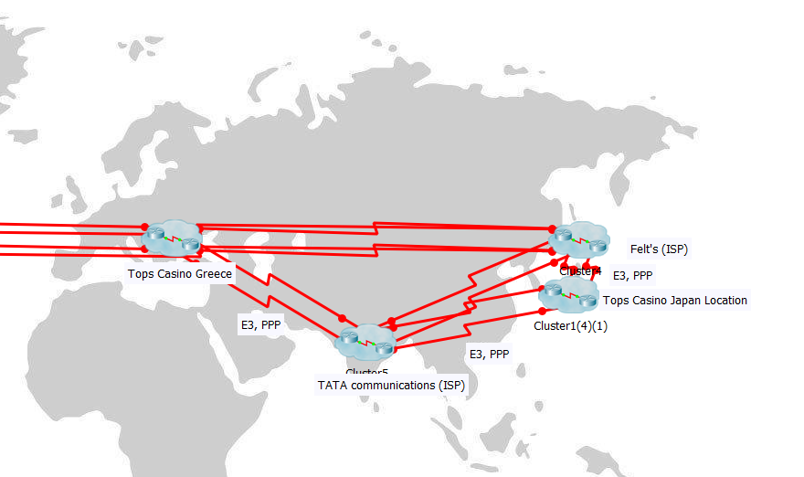
WAN Physical

Slide 25
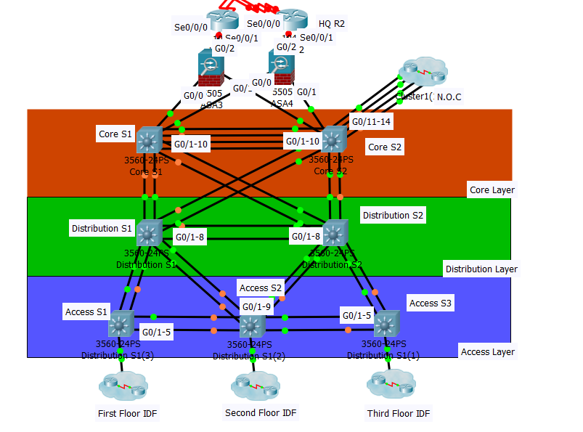
LAN Physical HQ

Slide 26
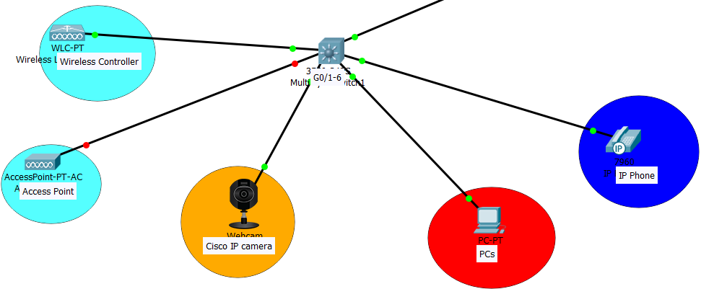
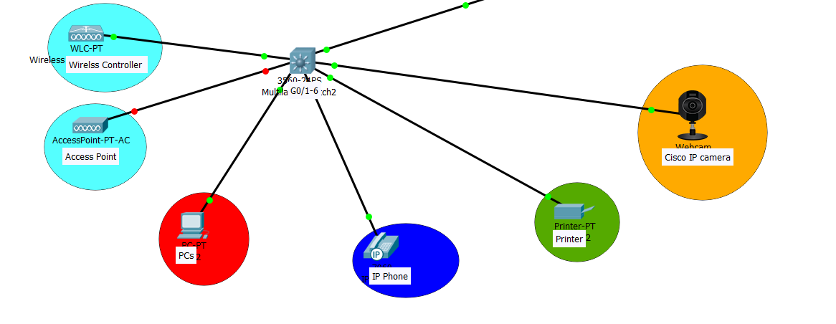
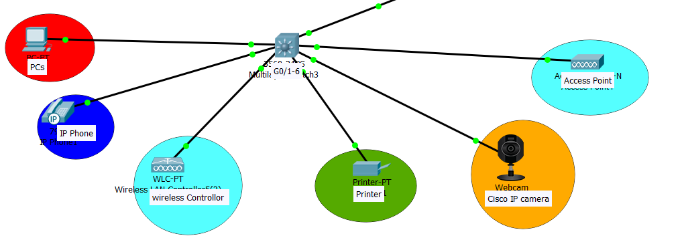
LAN Physical HQ Floor 1-3
Floor 1
Floor 2
Floor 3

Slide 27
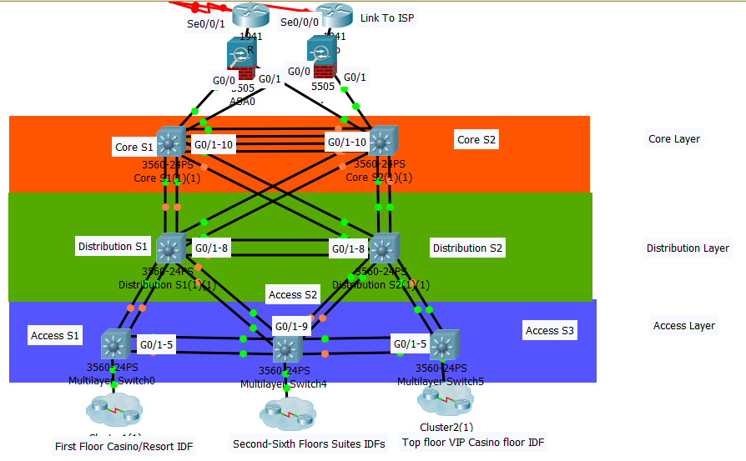
LAN Physical Hotel

Slide 28
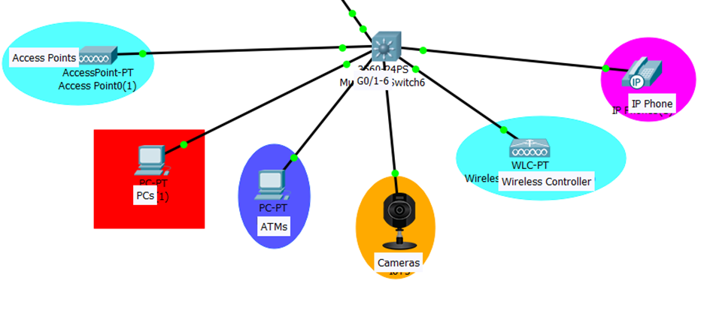
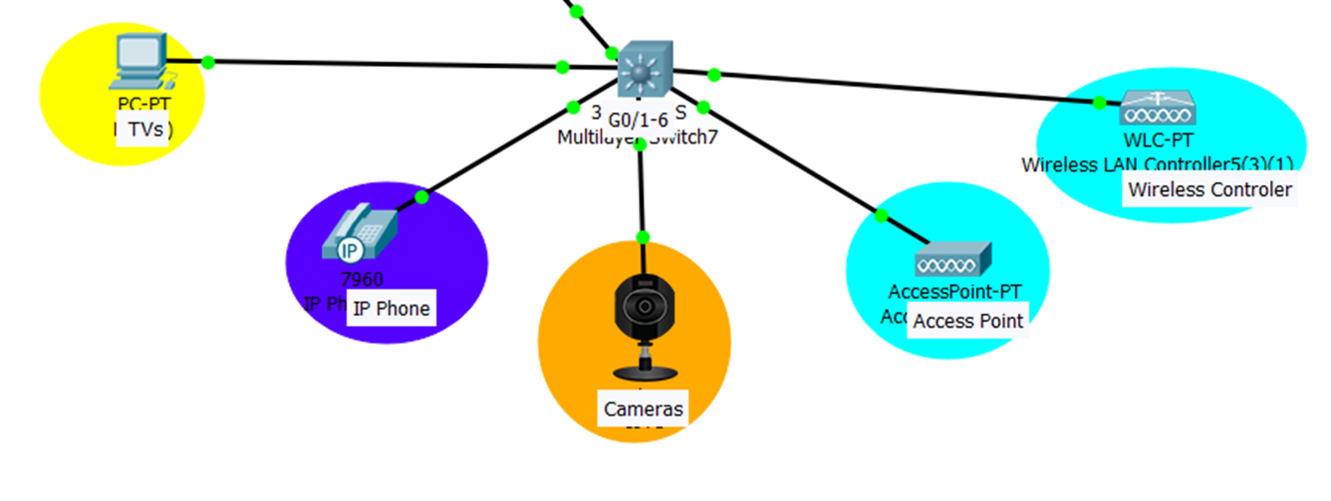
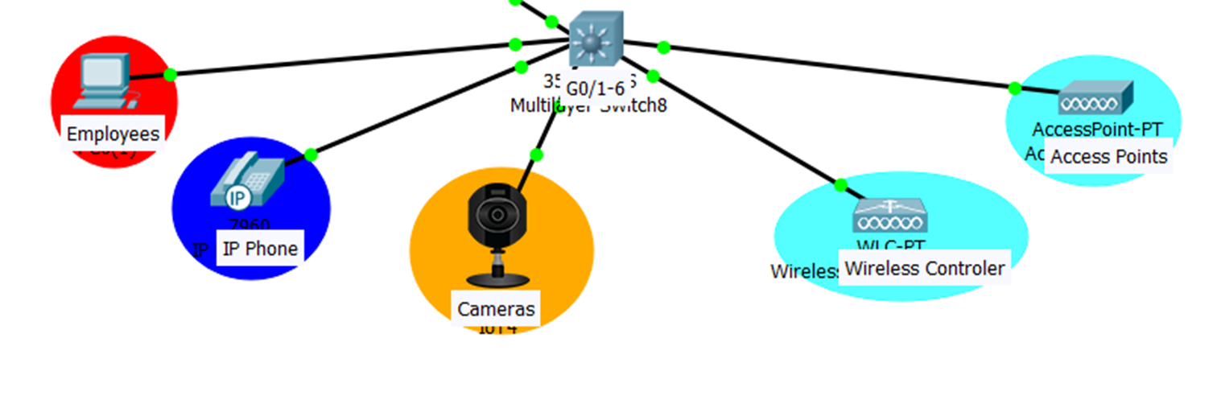
LAN Physical Casino/Hotel Floors
Floor 1
Floor 2-7
Floor 8

Slide 29
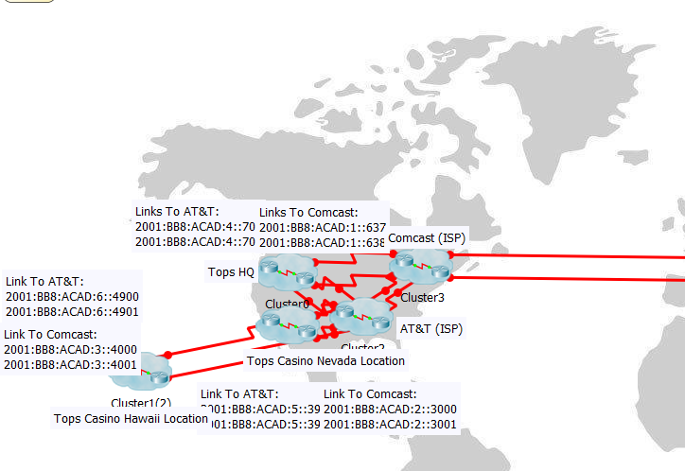
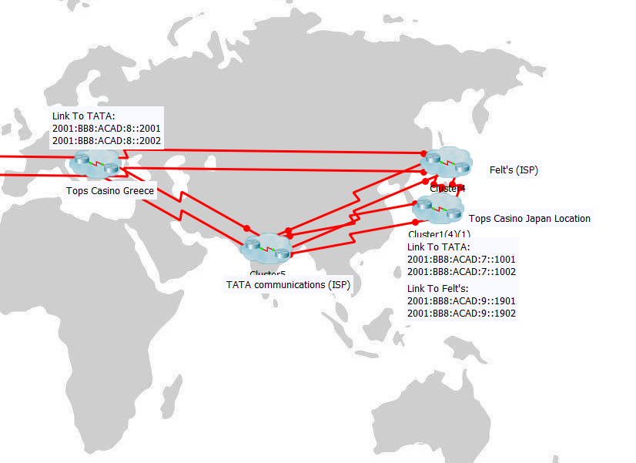
Wan IPv6 Logical

Slide 30
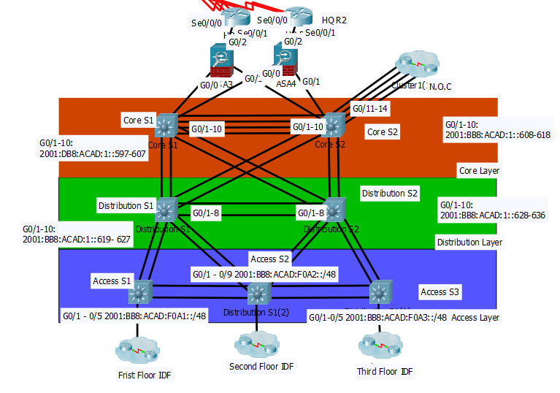
IPv6 LAN Logical HQ

Slide 31
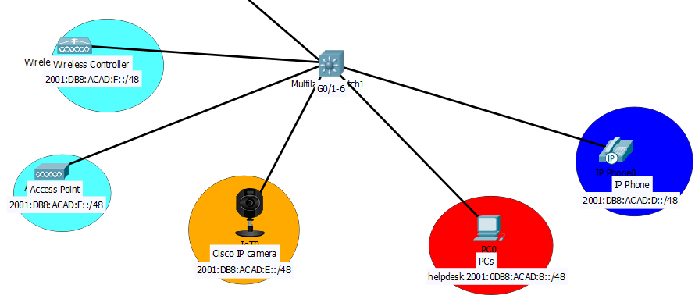
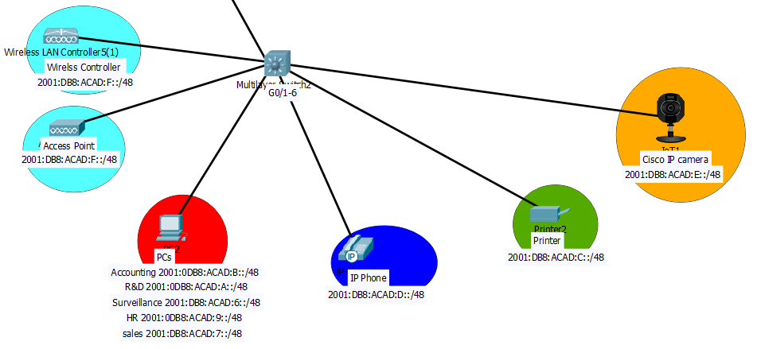
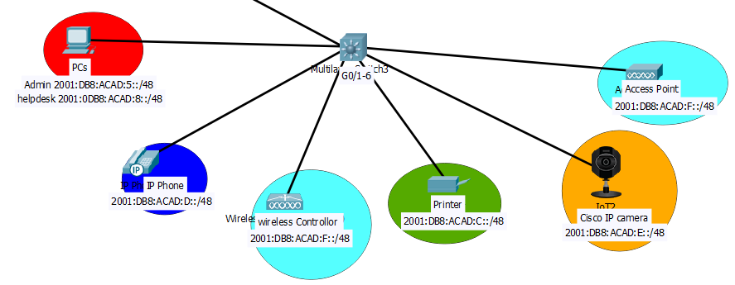
IPv6 LAN Logical HQ Floors
Floor 1
Floor 2
Floor 3

Slide 32
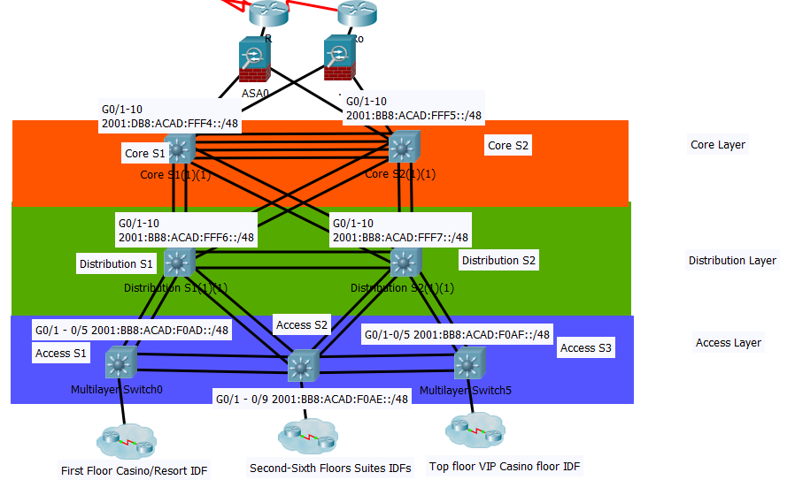
IPv6 LAN Logical Hotel

Slide 33
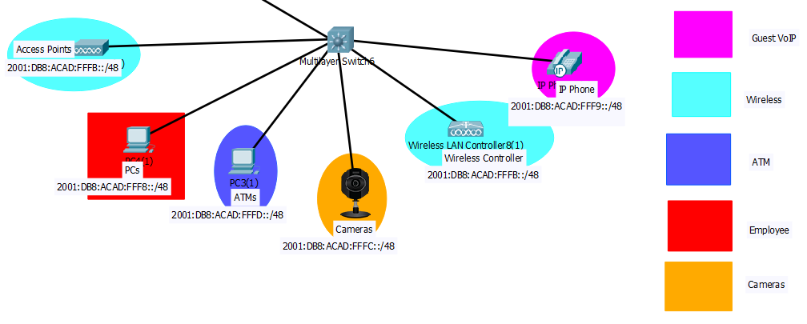
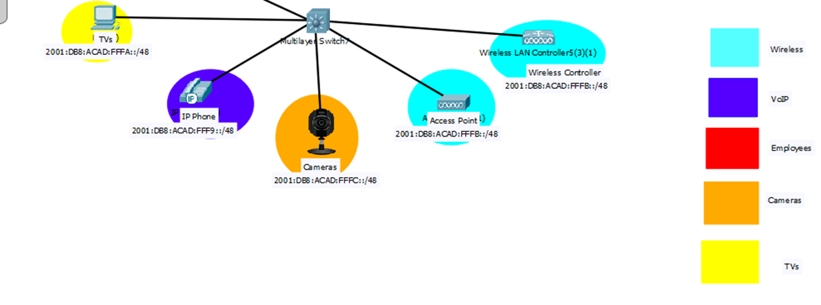
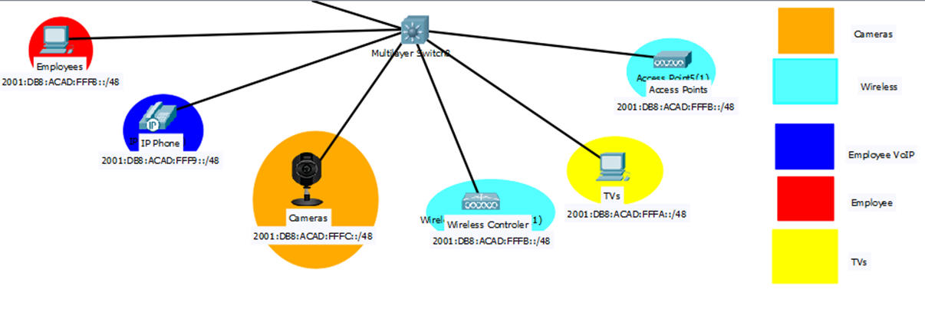
IPv6 LAN Logical Casino/Hotel Floors
Floor 1
Floor 2-7
Floor 8

Slide 34
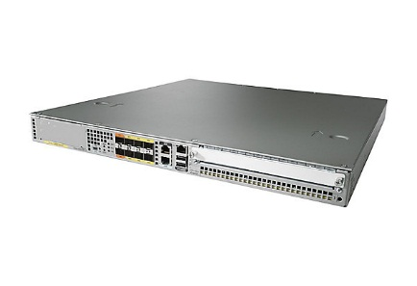
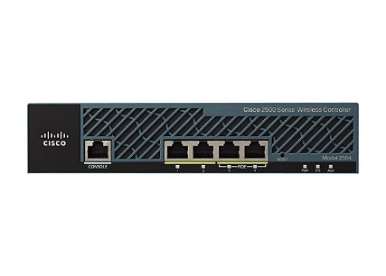
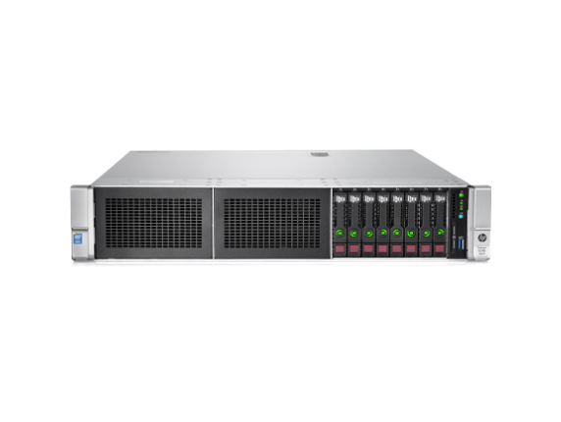
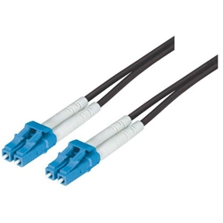
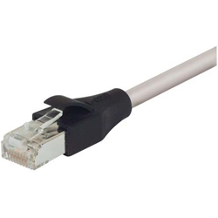

Cisco ASR 1001-X - router - rack-mountable
Cisco 2504 Wireless Controller
Price: $19,315.99
Price:$4,397.99
9/125 Single Mode, Military Fiber Cable, Dual LC / Dual LC, 1.0m
HPE ProLiant DL380 G9 2U Rack Server - 2 x Intel Xeon E5-2670 v3 Dodeca-core (12 Core) 2.30 GHz - 64 GB Installed DDR4 SDRAM
Price: $59.00
$6,699.00
Industrial Grade Category 5E Double Shielded LSZH Patch Cord, 100.0 ft
Cisco ASR 1000 Series Fixed Ethernet Line Card - expansion module
Price: $180.93
Price: $26,883.00

Slide 35






Cisco Catalyst 9400 Series chassis - switch - rack-mountable
Cisco Meraki MV21 - network surveillance camera
Price: $5,806.99
Price: $898.99
Cisco IP Phone 7811 - VoIP phone
Cisco Catalyst 9400 Series Line Card - switch - 48 ports - plug-in module
Price: $169.99
Price: $6,532.99
Cisco Meraki MR53 - wireless access point
Cisco Catalyst 9400 Series Line Card - switch - 24 ports - plug-in module
Price: $17,208.99
Price: $1149.99

Slide 36






$1,723.06
$5,903.71
Promethean ABMTSUPG-DST ActivBoard Mount With Short Throw Projector
Promethean AP4-70E ActivPanel Touch 70" Interactive Flat Panel
New Hyosung 2700 Shell ATM Machine (EMV Compliant)
New Inspiron 24 3000 Series (Intel®) Touch
Price: $1,745.00
Price: $769.99
55" Class MU6490 Curved 4K UHD TV
APC Power-Saving Back-UPS Pro 1300
Price: $699.99
Price: $209.99

Slide 37

Equipment Costs

Slide 38


Equipment Costs

Slide 39








Consulting and ISP cost

Slide 40
PROJECT TIMELINE
July 16,2018- August,6 2018: Delivery and revival of all equipment needed
August 26 – 27, 2018: Installation for HQ is officially completed.
May 16, 2018: Meet with the Client and offer a network proposal.
May 23,2018:
Present the network layout for the Headquarters and for the four Casinos.
June 4,2018:
Order the equipment needed for the new infrastructure and to be delivered to a decided location
August 8,2018: Begin installing new wiring for the new infrastructure and plan with ISPs
September 12-13, 2018: Equipment installation for the four Casinos officially completed.
May 20, 2018: Meet with the client to observe the buildings.
May 28, 2018:
Discuss any necessary changes with the layout or pricing of the network infrastructure.
June 6, 2018: Hiring of Subcontractor and contacting of ISPs
September 14, 2018:
Completion of project
August 7, 2018: Begin Configurations on all of the networking equipment for the infrastructure
August 20, 2018: Begin testing all devices

Slide 41
Pro’s and Con’s
Pro’s
Scalability
Reliability
Low Latency
Efficiency
Redundancy
Con’s
Expensive

Slide 42
Special Thanks
Jerry Osorio (Mentor)
Kevin Arita (Mentor)
Marlon Vernon (Instructor)
Judges

Slide 43


Slide 44


